Slide 1
Housing vs. Expenses
Q: Does your location on or off campus affect your weekly expenses? Is it really cheaper to live off campus?
Bella Davies, Frederic Lemonnier, Eugenia Lim, Virushi Patel, Madhri Yehiya, and Enzo Yumiketa
Notes:
Madhri

Slide 2
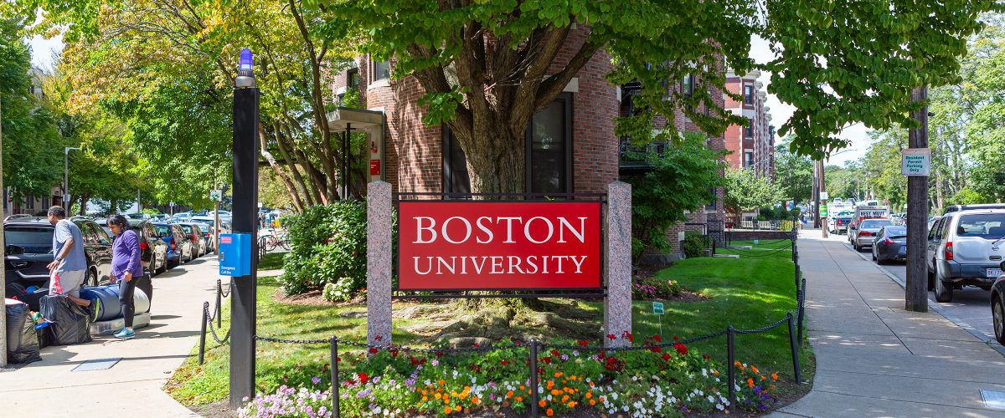
Study Background
As sophomores who all live on campus, the possibility of living off campus next year was something of interest.
We were curious if living off campus is still worth it the farther away the location is from Central Campus.
Notes:
Madhri

Slide 3

Questions
“Is there a significant difference between student’s weekly spending and where they live?”
“Is it REALLY cheaper to live off campus?”
“Does the cost of transportation and food living off campus outweigh living in an expensive on campus dorm greater than 0.5 miles from Central Campus?”
Notes:
Madhri

Slide 4

Survey Questions
Graduation year?
Where do you live? > or < 0.5 miles from Central Campus
Example: Myles Standish Hall is 0.6 miles from CAS
Dining plan?
Weekly spending:
Groceries?
Eating out?
Transportation?
Weekly total?
Notes:
Bella

Slide 5

Hypothesis
It is more expensive to live on campus greater than 0.5 miles from Central Campus, defined as the College of Arts and Sciences, than living off campus when considering all the food and transportation expenses.
Notes:
Virushi

Slide 6
Null Hypothesis & Alternate Hypothesis
H₀: There is no significant difference in money spent on transportation for those that live on or off campus, within or greater than 0.5 miles from Central Campus.
H_{a}: Students who live greater than 0.5 miles away from Central Campus, on or off campus, spend more than those within 0.5 miles of Central Campus
Notes:
Bella

Slide 7

Experimental Method
To conduct our study, we sent a Google survey to hundreds of students in order to yield a sample size of at least 100
To properly account for the cost of food we included on-campus students’ dining plans into total spending to compare it to off-campus students’ spending on groceries and eating out.
This value was calculated by dividing the cost of a given student’s dining plan (another question on the survey) by 15 weeks in a semester to find the cost of food per week.
Notes:
Freddie

Slide 8

Pilot Study Issues
Pilot Study Issues:
Ambiguous data range for amounts spent weekly
Multiple choice range of questions
“Other” option for class year
Final Study Solutions:
Included “Other” option for housing selection, type of transportation
Included short answers amount for weekly spending which allowed for more accurate data
Sent out to wider population
Asked respondents for opinion regarding on campus vs. off campus price difference
Notes:
Eugenia

Slide 9
Preliminary Data Collection & Methodology
How did the Pilot Study affect our results and analysis?
First survey gave inaccurate results in the form of ranges, resulting in data we could not easily analyze or graph
Failed to consider dining plan; unable to determine how much students were spending on food total
Fewer than 70 respondents; very skewed sample size toward on campus sophomores (our group’s exact demographic); seemed to show that off campus students tend to spend more than those who live on campus
Notes:
Enzo

Slide 10
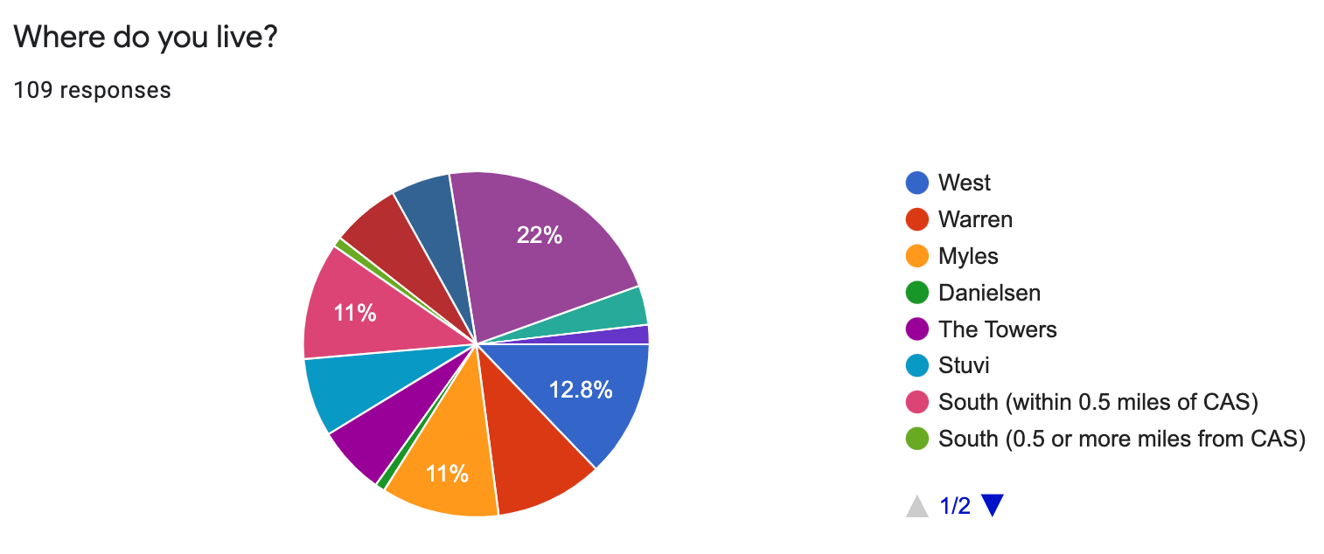
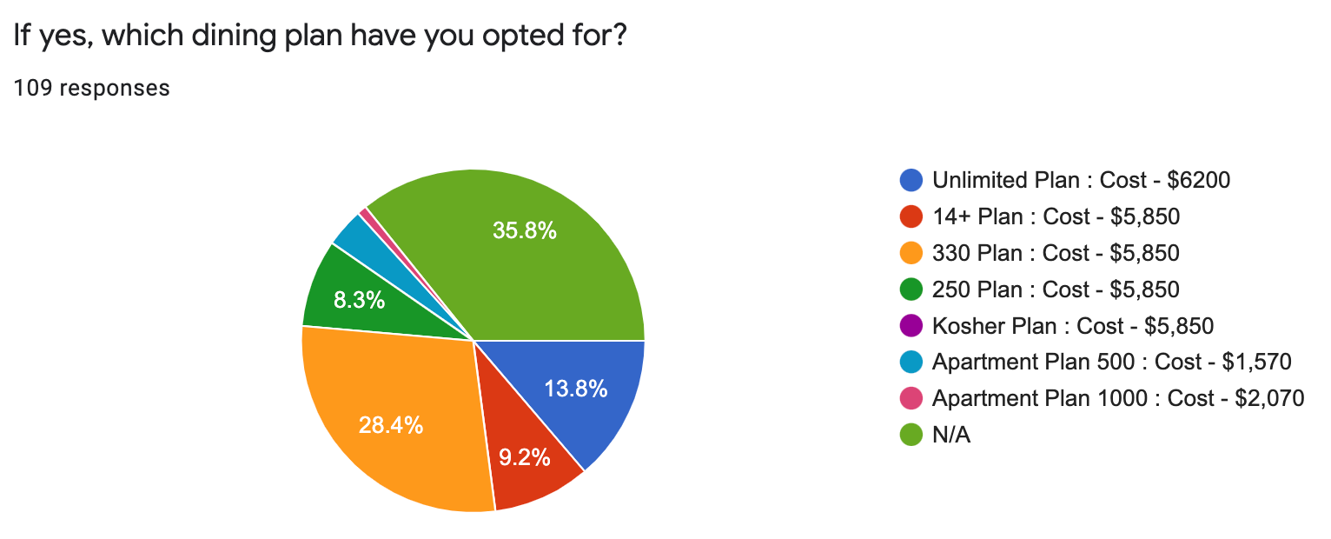
Notes:
Bella

Slide 11
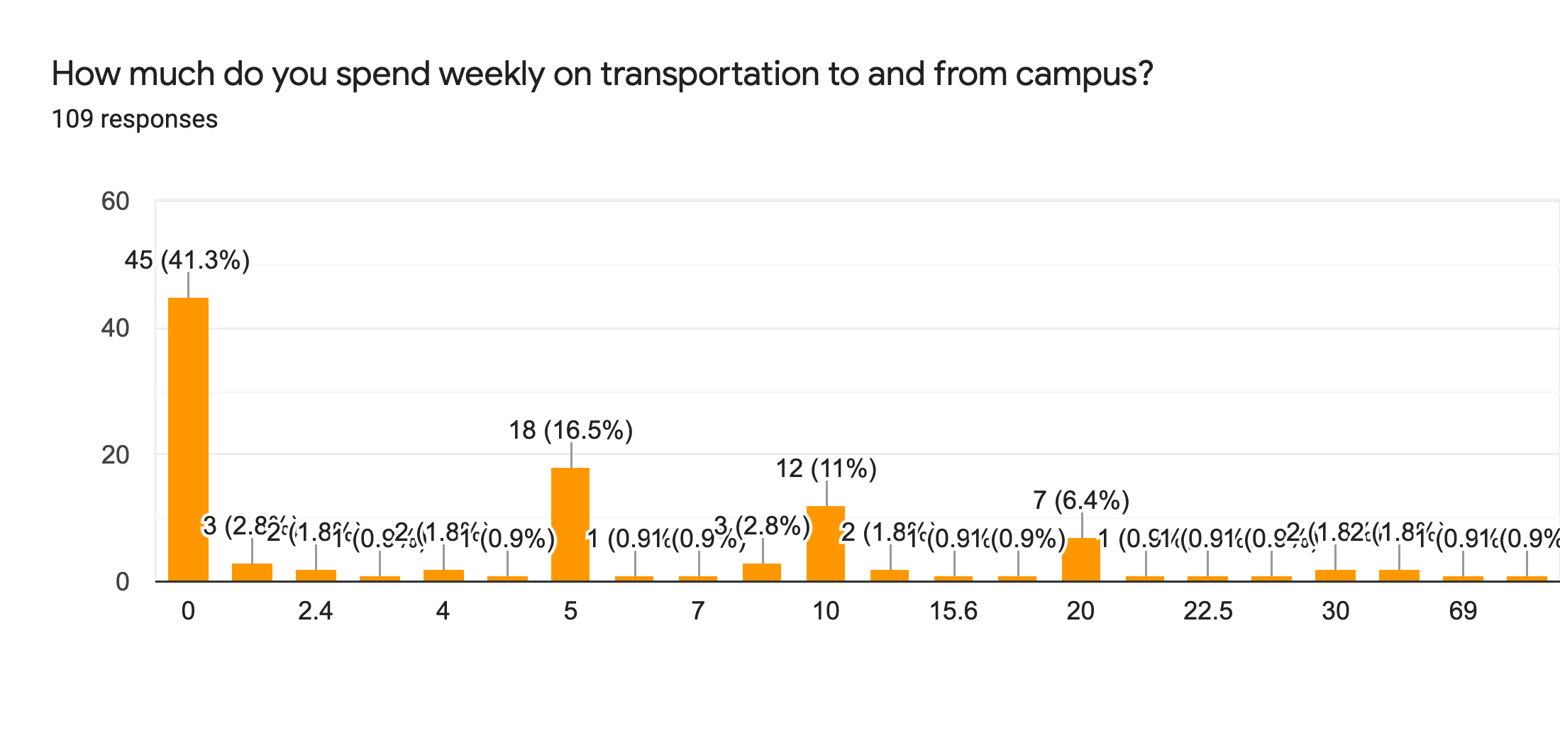
Notes:
Madhri

Slide 12

Demographics
Total of 109 responses
Respondents were mostly year of 2024
50% of freshmen thought living on campus was cheaper; other classes closer to 20%
11 different types of housing locations
A lot fewer respondents from Danielsen than anywhere else
Most respondents were from The Towers
Notes:
Frederic

Slide 13
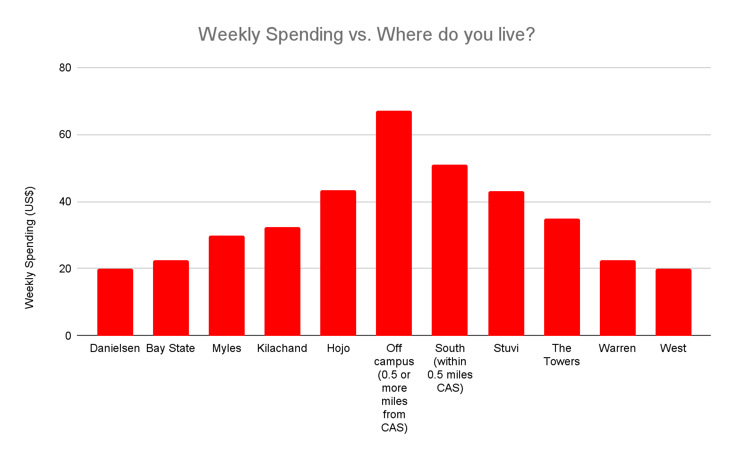
Results
Notes:
Enzo

Slide 14

Test Statistic
H0 : ( μ1 - μ2 ) = 0
H1 : ( μ1 - μ2 ) > 0
The test statistic Z Value that is calculated is −3.998454184. At α = 0.01, the z-value is 2.576. Since 2.576 is greater than -3.998, there’s evidence at α = 0.01, we cannot reject the null hypothesis.
Notes:
Virushi

Slide 15

Analysis
The weekly spending vs location of dorm does not specifically show that living off campus is cheaper
As some people who live closer spends as much as those who live farther away from central campus
No correlation between living off campus and spending less money than those who lived on campus
One reason for this could be that we did not factor in rent, though it is a marginal difference it could make the difference between on and off campus spending more clear
Notes:
Virushi

Slide 16
Conclusion
We were unable to reject the null hypothesis
Lack of significant difference between money spent for on campus residents vs. off campus residents
Explanation:
Did not factor in cost of housing (rent, dorm fees) like we did with food
Did not factor in financial aid or scholarships like housing grants that may impact students’ actual out-of-pocket spending
Some survey questions could have been more clear
“How much do you spend weekly on transportation to and from campus?”
Should have asked for monthly spending rather than weekly spending
Off-campus students might have forgotten certain monthly bills such as electricity, gas, water, wifi, etc.
Forgot to ask for demographics, such as gender, major, race, income level, international students
Notes:
Bella

Slide 17
What we learned
How to write a survey question that yields responses that can be used for analysis
Repeated trials and revisions are necessary to achieve something with an adequate Confidence Interval and causation > correlation argument
How to analyze data using test statistics and to form a conclusion that accepts or rejects the null hypothesis based on a real-life example
Perhaps once we move off campus ourselves, we can form a better hypothesis and survey resulting in more conclusive results :]
Notes:
Madhri

